Slide 1
Collaboration diagrams

Slide 2
Collaboration diagrams (known as Communication Diagram in UML 2.x) are used to show how objects interact to perform the behavior of a particular use case, or a part of a use case.
Unlike a sequence diagram, a collaboration diagram shows the relationships among the objects.
Sequence diagrams and collaboration diagrams express similar information, but show it in different ways.

Slide 3
A Collaboration is a collection of named objects and actors with links connecting them. They collaborate in performing some task.
A Collaboration defines a set of participants and relationships that are meaningful for a given set of purposes
A Collaboration between objects working together provides emergent desirable functionalities in Object-Oriented systems

Slide 4
Each object (responsibility) partially supports emergent functionalities
Objects are able to produce (usable) high-level functionalities by working together
Objects collaborate by communicating (passing messages) with one another in order to work together

Slide 5
Notations of Collaboration Diagram Objects
Object_name : class_name
You can use objects in collaboration diagrams in the following ways:
Each object in the collaboration is named and has its class specified
Not all classes need to appear
There may be more than one object of a class

Slide 6
An object’s class can be unspecified.
Normally you create a collaboration diagram with objects first and specify their classes later.
The objects can be unnamed, but you should name them if you want to discriminate different objects of the same class.

Slide 7
Actors
Normally an actor instance occurs in the collaboration diagram, as the invoker of the interaction.
May have multiple actors
Each Actor is named and has a role
One actor will be the initiator of the use case

Slide 8
Links
Links connect objects and actors and are instances of associations and each link corresponds to an association in the class diagram
A link is a relationship among objects across which messages can be sent.
In collaboration diagrams, a link is shown as a solid line between two objects.

Slide 9
An object interacts with, or navigates to, other objects through its links to these objects.
A link can be an instance of an association, or it can be anonymous, meaning that its association is unspecified.
Message flows are attached to links, see Messages.

Slide 10
Messages
A message is a communication between objects that conveys information with the expectation that activity will ensue. In collaboration diagrams, a message is shown as a labeled arrow placed near a link.
The message is directed from sender to receiver
The receiver must understand the message
The association must be navigable in that direction

Slide 11
Steps for Creating Collaboration Diagrams
Identify behavior whose realization and implementation is specified
Identify the structural elements (class roles, objects, subsystems) necessary to carry out the functionality of the collaboration
Decide on the context of interaction: system, subsystem, use case and operation
Model structural relationships between those elements to produce a diagram showing the context of the interaction
Consider the alternative scenarios that may be required
Draw instance level collaboration diagrams, if required.
Optionally draw a specification level collaboration diagram to summarize the alternative scenarios in the instance level sequence diagrams

Slide 12
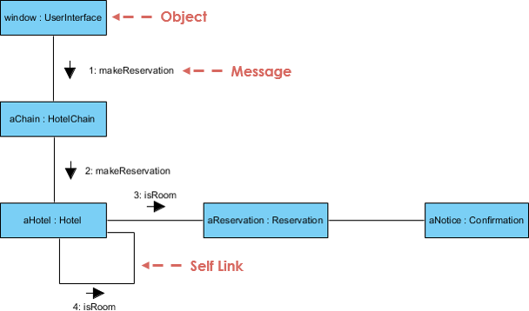
Collaboration Diagram Example

